Slide 1
Internet Censorship and Online Speech Chapter 8: Legal Aspects of Content Moderation
Nick Feamster University of Chicago

Slide 2
Internet Censorship and Online Speech Chapter 8.1: Laws and Censorship
Nick Feamster University of Chicago

Slide 3
Central Questions
To what extent is an ISP (or content platform) responsible for the speech on its platform?
To what extent is the cost of Internet a financial nudge towards certain types of content?

Slide 4
Relationship Between Laws and Censorship
Laws are often the basis for whether content is published, stays online, is removed, etc.
Control of online speech can take various flavors:
Copyright
Online content moderation
Network neutrality (blocking, throttling, prioritization)

Slide 5
Topics of Discussion
Legal Considerations
Communications Decency Act, Section 230
Reno vs. ACLU (1997)
Digital Millennium Copyright Act
Anti-SLAPP (Strategic Lawsuit Against Public Participation)
Technical Enforcement of Copyright
Net Neutrality and Zero Rating

Slide 6
Internet Censorship and Online Speech Chapter 8.1: Legal Aspects of Content Moderation
Nick Feamster University of Chicago

Slide 7
Communications Decency Act

Slide 8
Communications Decency Act (1996)
Overall law was intended to protect minors online.
Most of the law was ruled unconstitutional.
Section 230 of the law was upheld:
Protects Internet Service Providers (ISPs) and content platforms from being liable for the words of others.
Remains law today, though has been subject to challenge.

Slide 9
Supreme Court Case: Reno vs. ACLU (1997)
Answered: What laws apply to online content?
First Supreme Court ruling on regulation of materials applied to the Internet.
Ruling: CDA was overbroad. Preserved restrictions on obscenity, child pornography.
Guaranteed significant First Amendment protections for online/Internet communications. (More like print media than regulations that broadcast media are subject to.)

Slide 10
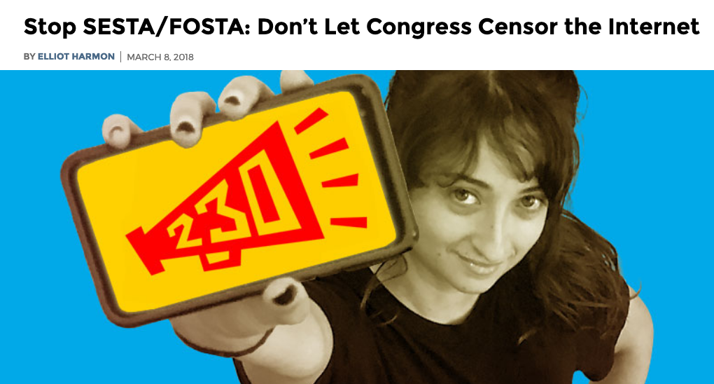
Recent Amendments: FOSTA/SESTA (2018)
Amends Section 230 of the CDA so that sex trafficking is not immune
Makes it illegal for websites to profit from sex trafficking (e.g., backpage.com)
Criticized by some free speech groups as “Internet censorship bill”
Has some implications for automated detection/enforcement/takedown.

Slide 11
Intermediary Liability: Summary
Platforms and ISPs generally enjoy safe harbor protection and are not liable for the content and speech of their users.
Recently, laws have clarified certain cases and domains (e.g., sex trafficking).
Mandates concerning intermediary liability have implications for censorship/speech, and may also favor incumbents.

Slide 12
Digital Millennium Copyright Act

Slide 13
Digital Millennium Copyright Act (1998)
Production and dissemination of technology, devices, services that circumvent access control on copyrighted works is illegal.
Key Point: ISPs and content providers have limited liability for copyright infringement by their users. (Title II “Safe Harbor”)
Limitations on liability: The ISP/content provider must act in accordance with takedown notices. (Section 512)

Slide 14
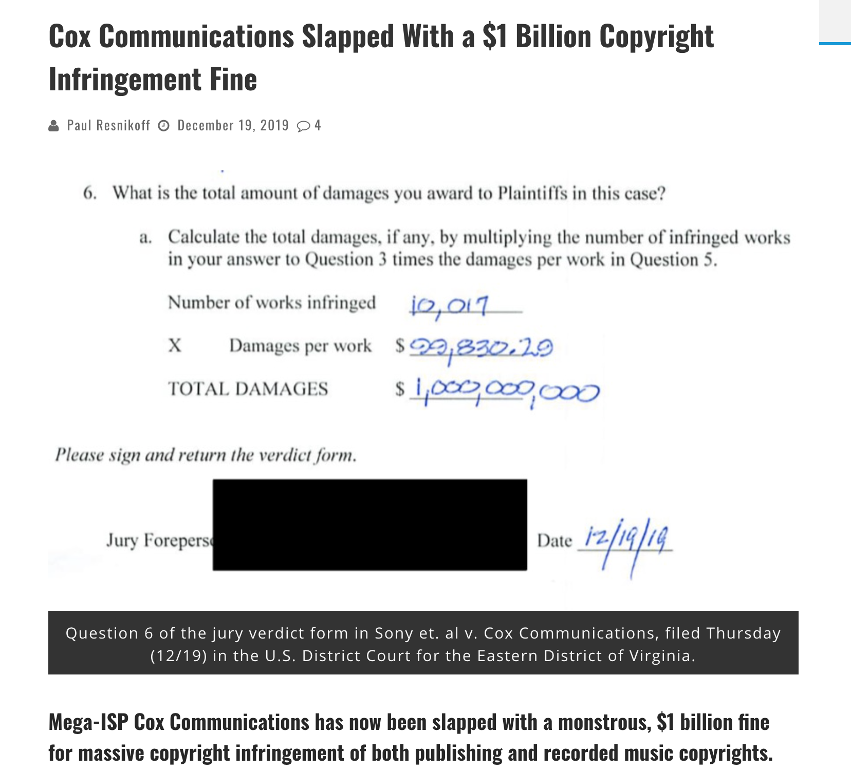
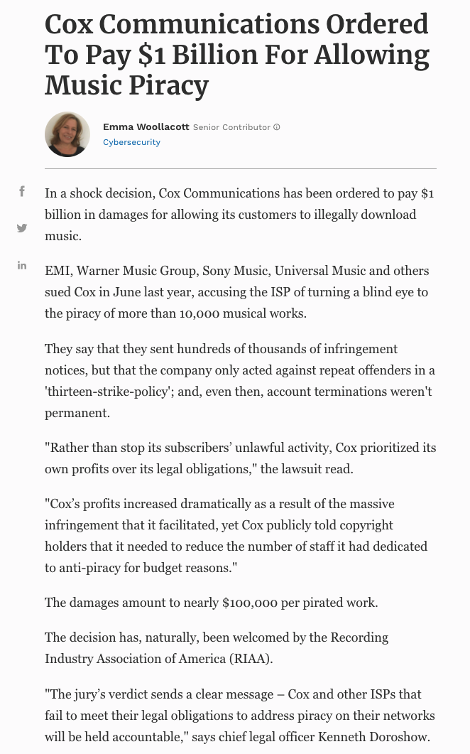

Slide 15
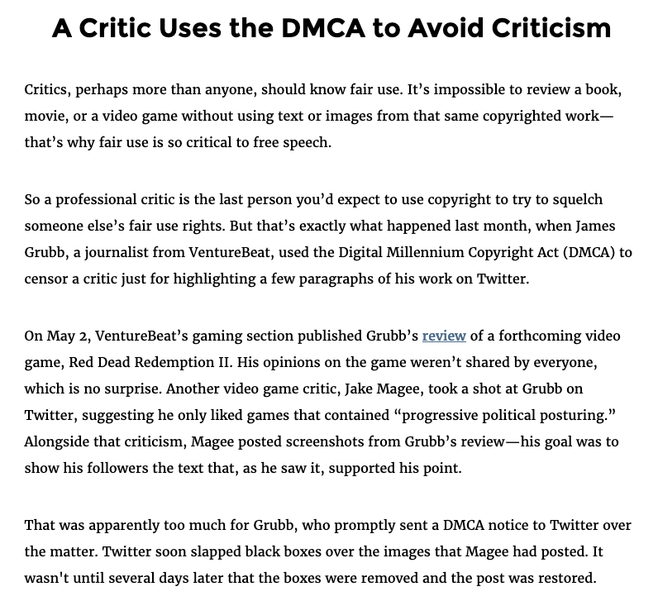
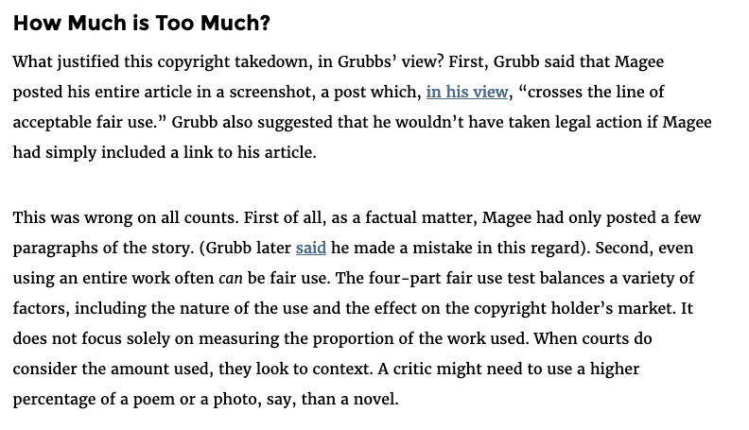
DMCA Takedowns and Censorship
https://www.eff.org/takedowns/critic-uses-dmca-avoid-criticism

Slide 16
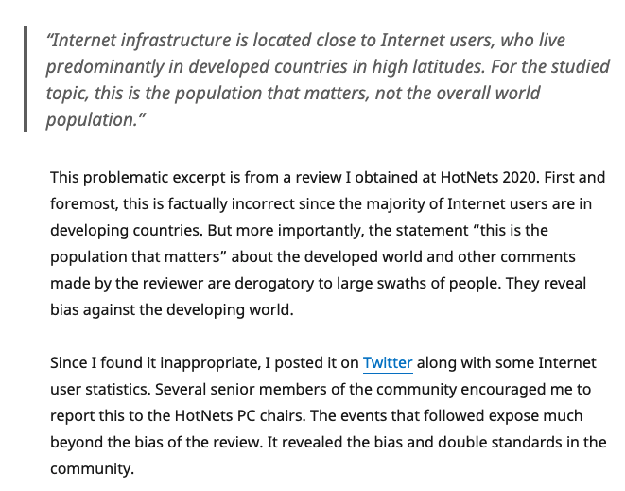
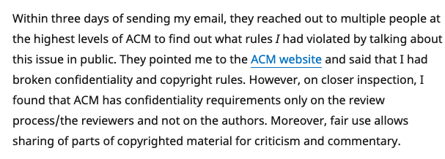
Copyright to Censor Speech: A Recent Example in Academia

Slide 17
Copyright Laws and Censorship
Intermediary liability varies by country
In some countries, outdated laws blur the distinction between content distributor/intermediary and regular Internet user, making the regulatory jurisdiction unclear.

Slide 18
Strategic Lawsuit Against Public Participation (SLAPP)

Slide 19
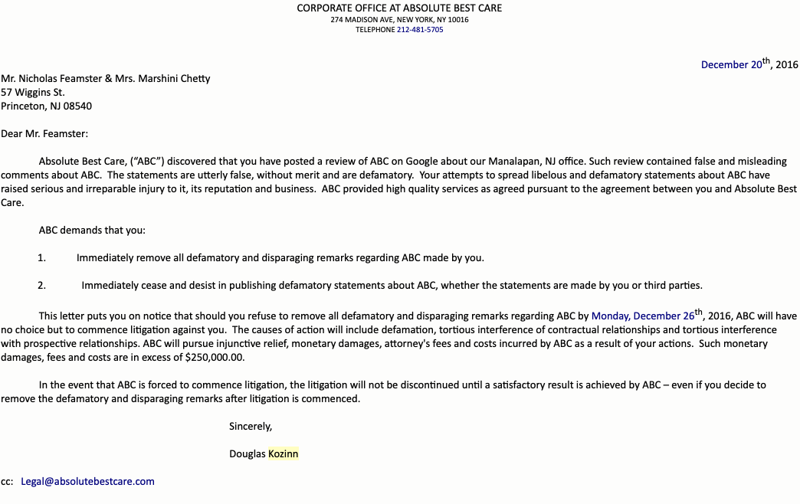
Strategic Lawsuit Against Public Participation (SLAPP)
Lawsuit filed by plaintiff to intimidate, censor, and silence critics.
Plaintiff typically does not intend to win
Goal is to get the defendant to cede, on the basis of fear, threat of legal fees, etc.

Slide 20
Anti-SLAPP: Active Area of Legislation
29 states have “Anti-SLAPP” laws as of 2019, but some of these laws have been struck down as unconstitutional (https://anti-slapp.org/your-states-free-speech-protection/)
Some countries have anti-SLAPP laws
For example, in British Columbia: Protection of Public Participation Act (https://www.bclaws.gov.bc.ca/civix/document/id/complete/statreg/19003)

Slide 21
Summary
The law is often used to implement censorship through a variety of tactics
Sometimes the speech itself is made illegal directly, but in many cases, the levers are indirect (fear, intimidation, legal costs, etc.)
Laws in seemingly unrelated areas (copyright) can also be used to censor

Slide 22
Internet Censorship and Online Speech Chapter 8.2: Technical Copyright Enforcement
Nick Feamster University of Chicago

Slide 23
How BitTorrent Works
User clicks on download link
Gets torrent file with content hash, IP address of tracker
User’s BitTorrent (BT) client talks to tracker
Tracker tells it list of peers who have file
User’s BT client downloads file from peers
User’s BT client tells tracker it has a copy now, too
User’s BT client serves the file to others “for a while”
Provides significant download bandwidth, without expensive server or network links.
Notes:
Explain hash.
e.g. let’s look at how a popular cooperative file-sharing system, BitTorrent, works.
Say you’re the user, want to download latest Linux kernel. You click on torrent download link. This gets a torrent file that contains hashes of chunks of the file, and IP address of a tracker node. Tracker node is web server to coordinate group of peers.
The client sends an HTTP request to the tracker telling it which file it wants, then the tracker responds with a list of peers who have the file.
D/L the file from peers, in parallel. Note only metadata--not file data -- are exchanged with centralized server, and only during the transient lifetime of a download.
--
Client switches roles → “server” peers to serve others.

Slide 24















How BitTorrent Works
HIGH HOPES
Peer 4
Peer 2
HIGH HOPES
Tracker
HIGH HOPES SHA1 1234ABCD4567EFGH
Peer 1 | 1 | 2 | 3 | 4
Peer 2 | 1 | 2 | 3 | 4
Peer 3 | 1 | 2 | 3 | 4
Peer 4 | 1 | 2 | 3 | 4
Peer 5 | 1 | 2 | 3 | 4
HIGH HOPES
Peer 3
Who has “High Hopes”?
Peer 1
HIGH HOPES
HIGH HOPES
Peer 5

Slide 25
How BitTorrent Works
HIGH HOPES
Peer 4
Peer 2
HIGH HOPES
Tracker
HIGH HOPES SHA1 1234ABCD4567EFGH
Peer 1 | 1 | 2 | 3 | 4
Peer 2 | 1 | 2 | 3 | 4
Peer 3 | 1 | 2 | 3 | 4
Peer 4 | 1 | 2 | 3 | 4
Peer 5 | 1 | 2 | 3 | 4
HIGH HOPES
Peer 3
Who has “High Hopes”?
Peer 1
HIGH HOPES
HIGH HOPES
Peer 5

Slide 26


How BitTorrent Works
HIGH HOPES
Peer 4
Peer 2
HIGH HOPES
Tracker
HIGH HOPES SHA1 1234ABCD4567EFGH
Peer 1 | 1 | 2 | 3 | 4
Peer 2 | 1 | 2 | 3 | 4
Peer 3 | 1 | 2 | 3 | 4
Peer 4 | 1 | 2 | 3 | 4
Peer 5 | 1 | 2 | 3 | 4
HIGH HOPES
Peer 3
Peer 1
HIGH HOPES
HIGH HOPES
Peer 5

Slide 27
How BitTorrent Works
HIGH HOPES
Peer 4
Peer 2
HIGH HOPES
Tracker
HIGH HOPES SHA1 1234ABCD4567EFGH
Peer 1 | 1 | 2 | 3 | 4
Peer 2 | 1 | 2 | 3 | 4
Peer 3 | 1 | 2 | 3 | 4
Peer 4 | 1 | 2 | 3 | 4
Peer 5 | 1 | 2 | 3 | 4
HIGH HOPES
Peer 3
Peer 1
HIGH HOPES
HIGH HOPES
Peer 5

Slide 28
How BitTorrent Works
HIGH HOPES
Peer 4
Peer 2
HIGH HOPES
Tracker
HIGH HOPES SHA1 1234ABCD4567EFGH
Peer 1 | 1 | 2 | 3 | 4
Peer 2 | 1 | 2 | 3 | 4
Peer 3 | 1 | 2 | 3 | 4
Peer 4 | 1 | 2 | 3 | 4
Peer 5 | 1 | 2 | 3 | 4
HIGH HOPES
Peer 3
Peer 1
HIGH HOPES
HIGH HOPES
Peer 5

Slide 29
How BitTorrent Works
HIGH HOPES
Peer 4
Peer 2
HIGH HOPES
Tracker
HIGH HOPES SHA1 1234ABCD4567EFGH
Peer 1 | 1 | 2 | 3 | 4
Peer 2 | 1 | 2 | 3 | 4
Peer 3 | 1 | 2 | 3 | 4
Peer 4 | 1 | 2 | 3 | 4
Peer 5 | 1 | 2 | 3 | 4
HIGH HOPES
Peer 3
Peer 1
HIGH HOPES
HIGH HOPES
Peer 5

Slide 30
How BitTorrent Works
HIGH HOPES
Peer 4
Peer 2
HIGH HOPES
Tracker
HIGH HOPES SHA1 1234ABCD4567EFGH
Peer 1 | 1 | 2 | 3 | 4
Peer 2 | 1 | 2 | 3 | 4
Peer 3 | 1 | 2 | 3 | 4
Peer 4 | 1 | 2 | 3 | 4
Peer 5 | 1 | 2 | 3 | 4
HIGH HOPES
Peer 3
Peer 1
HIGH HOPES
HIGH HOPES
Peer 5
Notes:
Changes: Have the last piece of the file transfer to the peer, so that High Hopes is complete

Slide 31
Piece Selection
Strict Priority
Rarest First
General rule
Random First Piece
Special case, at the beginning

Slide 32
Random First Piece
Initially, a peer has nothing to trade
Important to get a complete piece ASAP
Select a random piece of the file and download it

Slide 33
Rarest Piece First
Determine the pieces that are most rare among your peers, and download those first.
This ensures that the most commonly available pieces are left until the end to download.

Slide 34
P2P and Copyright: Important Considerations
Not every peer has the entire file, or even a usable piece of it.
P2P filesharing can suffer from “leechers” and “freeriders”
Peers may not always contain the complete copy of a file
Sometimes, even a “swarm” may not contain a complete copy of the file
Peers have incentives to lie about the pieces of the file that they have.
Having “rare” pieces of a file can result in more offers to trade pieces.
Peers can simply say that they have pieces that they do not have.
It is incumbent on the recipient to check those files.

Slide 35
Copyright Enforcement Systems
Examples of products
MarkMonitor
RightsCorp
High-level technical approach
Scanning
Join the peer-to-peer network
Search for content
Identify subscriber based on IP address
Sending notices (typically by email)

Slide 36
Copyright Enforcement: Design Decisions
How much of a file to download? Any of it? (Is complete file needed?)
When to verify the content? (Once? Every time?)
Is verification based on part of the file, the entire file, or metadata?
What is verification based on?
Advertised hash of the file?
Manual verification?
Fingerprint match based on part of the file? All of the file?

Slide 37
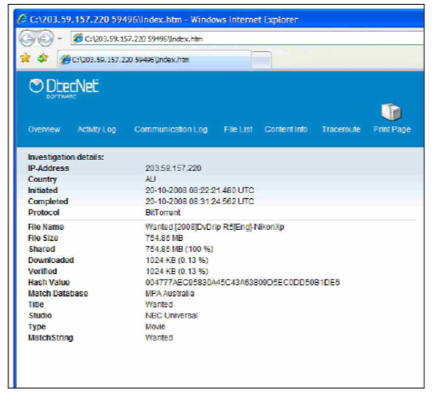
Copyright Enforcement Process
Some combination of manual review and automated scanning
For each infringer, the scanning agent gathers “evidence”
IP address
Time
ISP
SHA1 hash of file advertised by tracker
Network path to IP address/client
…

Slide 38
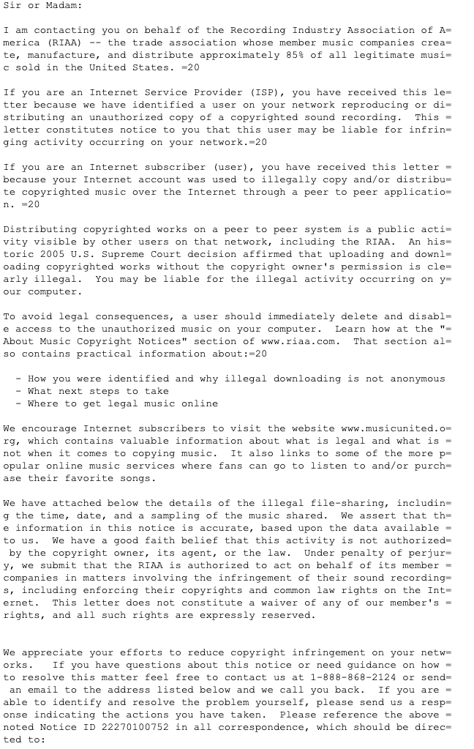
Notifications (to ISP)
Notifications sent to Internet Service Provider with the information as gathered above
Internet service provider expected to take action against the subscriber (including, as an extreme countermeasure, disconnecting the subscriber).

Slide 39
Questions
Is a peer distributing copyrighted content?
From where was that content obtained? (i.e., was it obtained legally?)
Is the content the work at issue, or is it something else (e.g., a commercial playing the work in the background, etc.)?
Does an IP address correspond to a single ISP subscriber? (Is it actionable?)

Slide 40
Copyright: Summary
Many technical questions concerning enforcement.
DMCA has some limited liability for ISPs and content providers, subject to compliance with takedowns.
DMCA (and copyright) can be used to censor speech.

Slide 41
Internet Censorship and Online Speech Chapter 8.3: Net Neutrality
Nick Feamster University of Chicago

Slide 42
Internet Business Model (Simplified)
Preferences implemented with local preference manipulation
Provider
Pay to use
Free to use
Peer
Get paid to use
Destination
Customer
Customer/Provider: One AS pays another for reachability to some set of destinations
“Settlement-free” Peering: Bartering. Two ASes exchange routes with one another.

Slide 43
Open Internet Order (2015; Invalidated): Reclassification of ISPs Under Title II
Bright Line Rules
No blocking
No throttling
No paid prioritization
No unreasonable interference or disadvantage
Transparency
… various exceptions for “reasonable network management” practices

Slide 44
The Open Internet Order (March 2015)
Reclassification of ISPs as “title 2” common carrier (forbearing many of the common clauses for title 2 providers). (Like a public utility.)
Upshot: ISPs prevented from discriminating.
Interestingly, content distribution networks were exempted from the process.
Perhaps we are barking up the wrong tree…

Slide 45
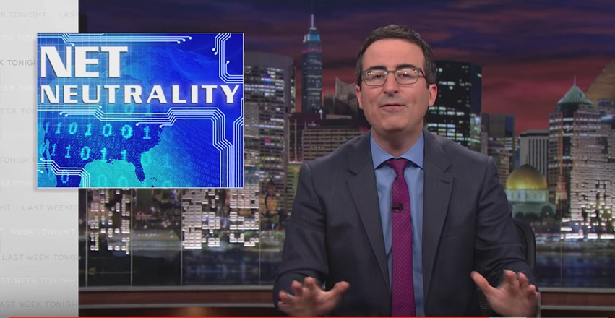
Internet Congestion and Network Neutrality

Slide 46
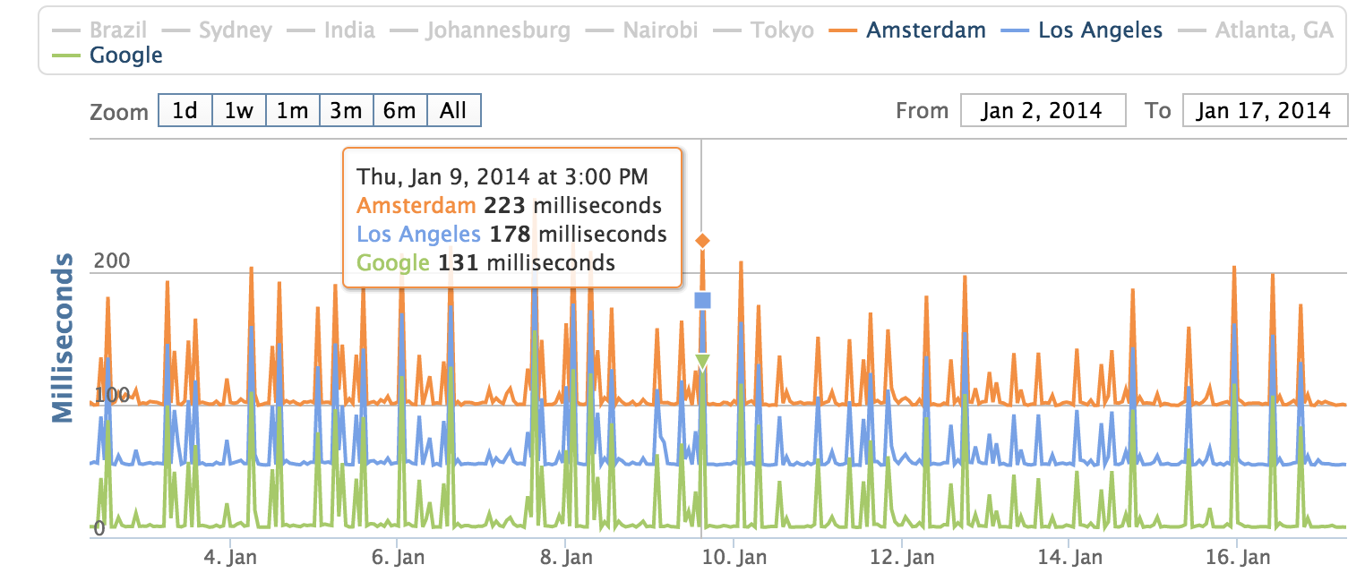
Internet Congestion at Home

Slide 47
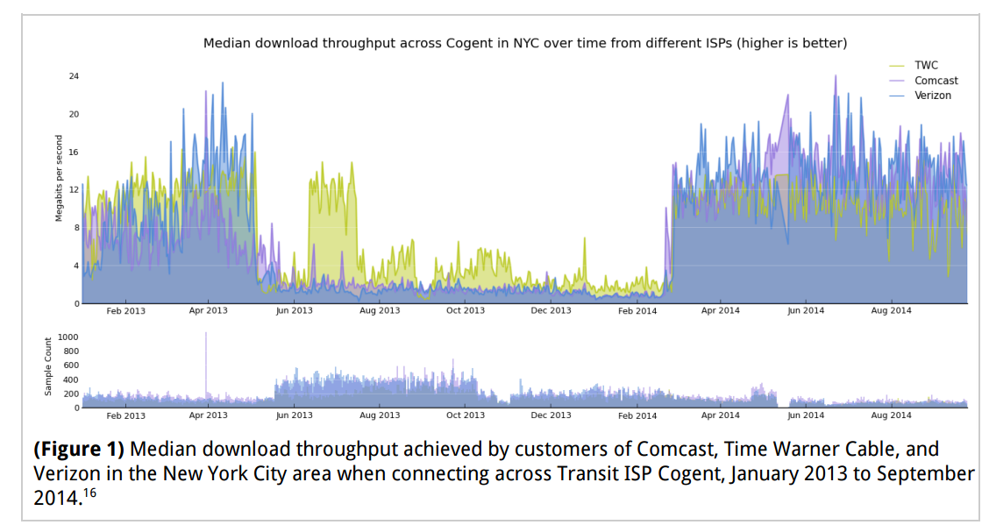
Another View: Across a Transit Provider

Slide 48
So… Was Comcast “Blocking” Netflix?

Slide 49
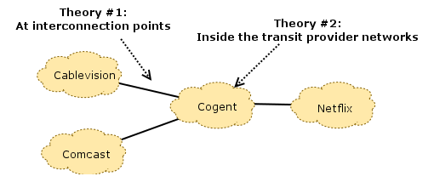
What’s Causing This?

Slide 50
Two Sides…
Netflix asserts that, by paying their transit providers, they have already paid for access to Comcast’s consumers (the “eyeballs”), and that it is the responsibility of Comcast and their transit providers to ensure that these links are provisioned well enough to avoid congestion. The filings assert that Comcast “let the links congest” (effectively, by not paying for upgrades to these links).
Comcast, on the other hand, asserts that Netflix has enough traffic to congest any link they please, at any time, as well as the flexibility to choose which transit provider they use to reach Comcast.

Slide 51
Net Neutrality: Summary
Net neutrality regulation in the U.S. is “dead” (for the time being)
Some provisions of net neutrality pertain to Internet censorship (e.g., blocking, throttling, paid prioritization).
Some aspects of Internet access relate to provisioning/economics/Internet peering and are somewhat fuzzy.

Slide 52
Internet Censorship and Online Speech Chapter 8.4: Paid Prioritization and Zero Rating
Nick Feamster University of Chicago

Slide 53
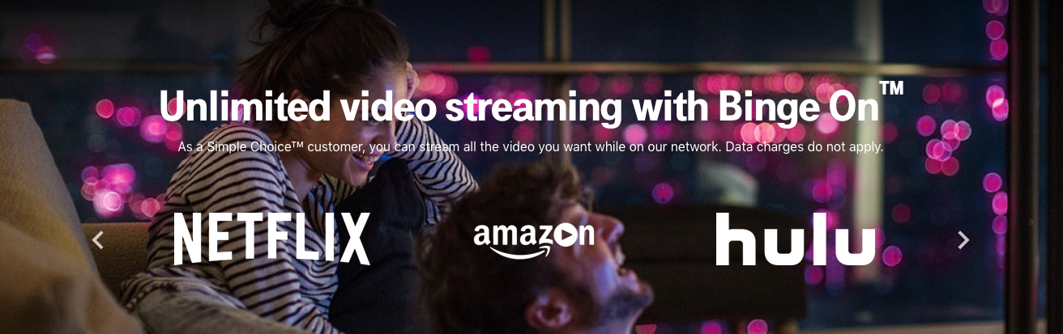
Paid Prioritization and “Zero Rating”

Slide 54
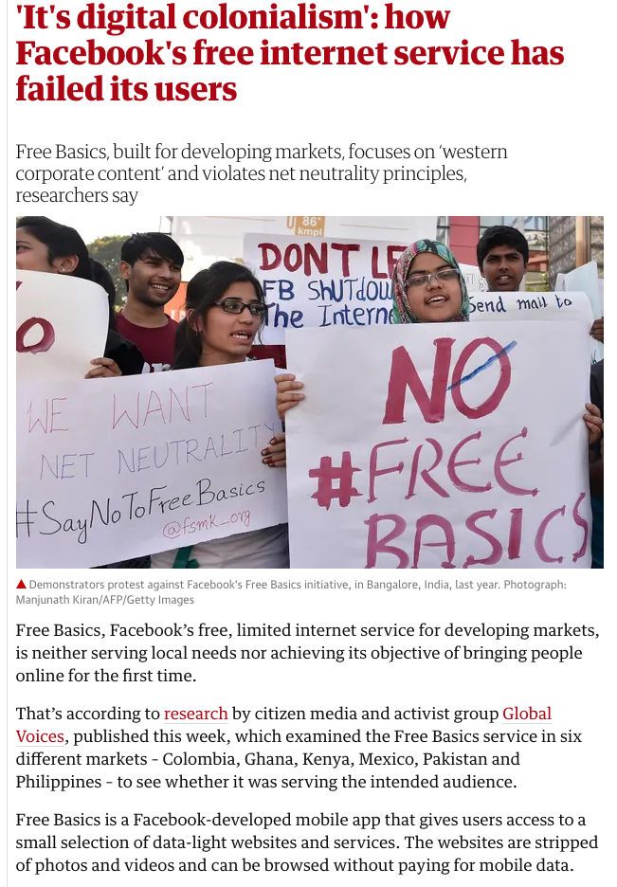
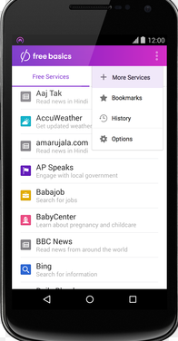
Facebook’s “Free Basics”
User gets access to some subset of applications for free (e.g., BBC News, …) without paying mobile carrier for data charges
Other sites incur regular carrier fees/data charges.

Slide 55
Walled Garden, or Gateway Drug?
Goal
Study mobile usage patterns in the context of pricing practices like zero-rating
Two Aspects:
Net neutrality & walled garden arguments
Connectivity & gateway drug arguments
Notes:
Motivation: analyze empirical relationships between different mobile data pricing practices and mobile data usage patterns, specifically zooming in on behavioral discrepancies between users on different data plans (unlimited vs. prepaid plans) and connection types (wifi vs. cellular). We also take into account practices like zero-rating and prepaid data pricing.
Particularly interested in the increasingly popular practice of zero-rating, which is when a mobile carrier or ISP offers free cellular data access to certain mobile services or applications. (cellular meaning anything 2G/3G/4G/LTE, etc. One big example of zero-rating is Facebook’s Free Basics mobile app offered in many developing countries. The app provides free access to a suite of basic services including health, job, and travel information.)
Net neutrality: carrier/regulator side, carriers should treat all bits of traffic flow equally, giving no priority based on payment to the service provider
Walled garden: consumer-side, zero-rating discourages users form venturing beyond the limited array of applications dictated by zero-rating service providers
Connectivity/gateway drug: zero-rated apps provide initial connectivity and serve as a gateway to usage of the full Internet
Examining the relationship between pricing effects and user behavior through this research can benefit all parties involved, including mobile users, network carriers and regulators, and mobile applications and organizations like Facebook’s Free Basics. For example, these insights can help users better understand how to manage their mobile data, which is increasingly relevant in developing countries like South Africa and Kenya, where we focus much of our research. These countries have witnessed the rise of modern phenomena like mobile leapfrogging (when users skip using fixed-line technologies like PCs and dive straight into the more affordable and convenient mobile option).

Slide 56
Approach
Longitudinal empirical analysis of mobile usage patterns
Comparative qualitative analysis of zero-rating effects
Data
MySpeed Test
Metadata
User behavior
Survey responses
Kenya and South Africa
Notes:
Key insight: analyze longitudinal data on a diverse range of global users to explore possible pricing effects on long-term mobile data usage patterns, in addition to collecting survey responses for a more focused comparative analysis on the impact of zero-rating in developing countries. An empirical analysis on this subject actually hasn’t been studied at great length before.
Another unique aspect of this research is that it makes use of new data that has never been analyzed for this purpose. Our two sources of data come from the MySpeedTest application and a survey instrument that we created and distributed to users in South Africa and Kenya.
MySpeedTest is a mobile application created in-house that collects data on a device’s network performance (e.g. throughput and latency), user behavior (e.g. data consumed and usage frequency of different applications), and metadata (e.g. country, datacap plan, battery life). We focus on the relationships between different pieces of metadata associated with the device, and the user behavior on that device.
We also distributed a survey instrument to about 300 South African and Kenyan users that largely focuses on questions involving zero-rating practices and mobile usage breakdowns. Some questions mirror those asked in a survey distributed by A4AI as part of its ongoing study, and a handful reflect questions asked in Mathur et al.’s study. This was done to cross-validate the consistency of our survey results against those found in the corresponding papers. A4AI’s survey was fairly relevant to our study, and later we will summarize our analysis of the data collected by their original survey. Mathur et al.’s work examines overall mobile usage behaviors in South Africa while ours focuses specifically on zero-rating effects.

Slide 57
Implementation
MySpeedTest data collection, cleaning, and preprocessing
Exploratory analysis
South Africa (US for comparison)
Connection types, datacap types
Pricing analysis
Zero-rating
Prepaid data pricing
OnDevice pay-per-install recruitment, Mechanical Turk trial
Comparative analysis
South Africa vs. Kenya
Survey data
Notes:
Our longitudinal analysis using the MySpeedTest data constituted the main portion of my thesis.
Data collection + cleaning and preprocessing:
Very iterative process because new dataset, had to figure out how to most efficiently work with it and continually make improvements to app’s interface and data collection process based on issues found, can go into more detail if anyone has questions
MySpeed Test data access through postgres db called androidperformance – main issues were latency effects (db located in georgia tech) and size of data (15-min intervals for collection of each active device/application pair, so potentially billions of rows of data per month)
Solution: aggregate by day to get daily measurements → less granularity but more manageable, preprocess data directly via sql queries to only bring in what was needed for analysis
Initial exploratory analysis: comparing usage between different countries, focusing on ZA to gain context for our later pricing analysis, with US as point of comparison.
Pricing analysis: focused on pricing practices in South Africa (more prevalent there), two examples of zero-rating (discuss later) and possible effects of varying prices of prepaid data plans for different carriers
Comparative analysis: South Africa vs. Kenya
Supplemented longitudinal analysis with a more comparative, qualitative approach through our South Africa and Kenya surveys. For this portion of the research, we tried two new recruitment methods: OnDevice research, which provides a pay-per-install recruitment guarantee, and Mechanical Turk, which we attempted to use for additional recruitment.

Slide 58
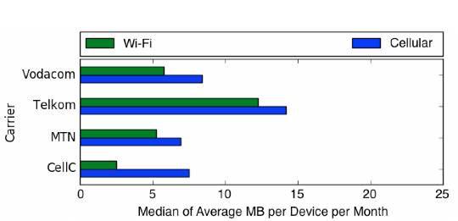
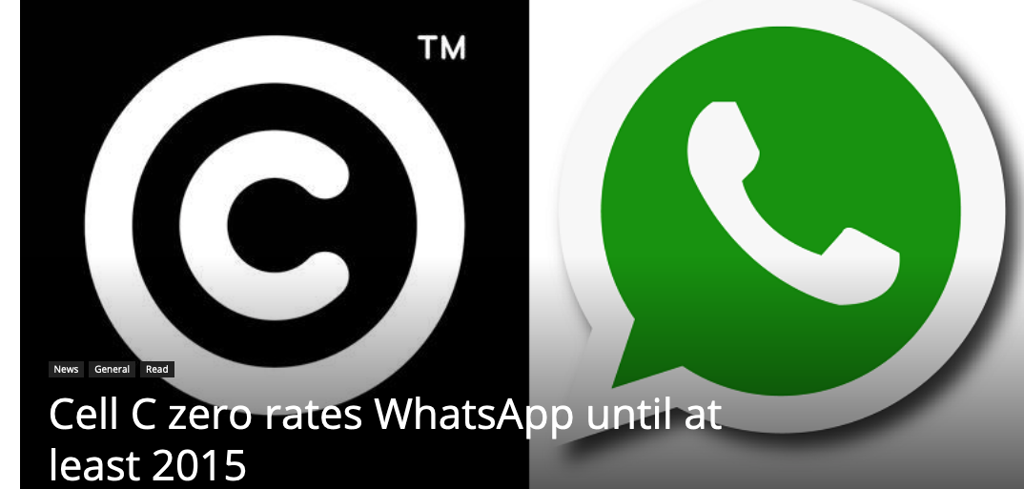
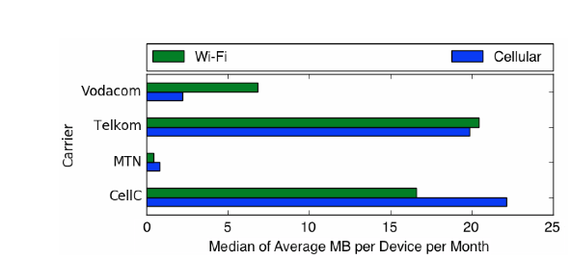
WhatsApp Usage: Effects of Zero Rating on Cell-C
Cellular usage of WhatsApp increased 3x on Cell-C during zero-rating period.
Other carriers usage also fluctuated for other carriers. Small N study (19 users total). May need more data to draw conclusions.
Notes:
Here we see WhatsApp's usage breakdown during Cell C's zero-rating period. Cell C usage has indeed shot up, with Wi-Fi usage increasing almost sevenfold to a median of around 17 MB of average monthly usage per device, and cellular usage increasing almost threefold to around 22 MB. This indicates that zero-rating WhatsApp may have had remarkable effects on its usage, greatly increasing the application's use not only on cellular connections (as was expected), but actually even more so on Wi-Fi connections. The fact that overall usage on Cell C seemed to increase so dramatically during this zero-rating period implies that perhaps WhatsApp became much more popular overall, regardless of connection type, because users felt they could use the app freely on any connection at no cost.
Oddly enough, we also see dramatic changes in WhatsApp usage for the other three carriers during this period. We found that the number of unique users on each carrier during this period may not be high enough to draw conclusive results, with only a handful of WhatsApp users on each carrier. 19 users total

Slide 59
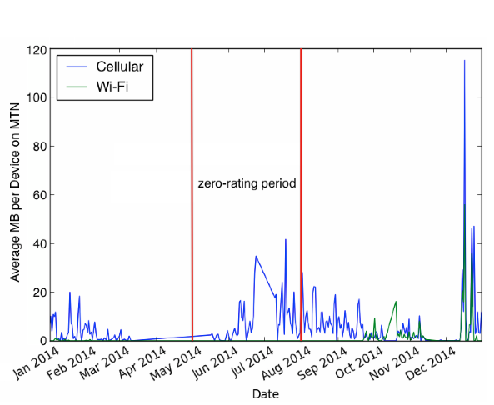
Effects of MTN’s Zero-Rating of Twitter During 2014 World Cup
Started during 2014 World Cup as promotion
Continued again later in 2014.
Recently discontinued in 2018.
Usage higher during and after initial zero-rating period.
Notes:
We know that MTN had a promotional event zero-rating Twitter from May through July 2014, delineated in the figure. Our results indicate much higher cellular usage in general than Wi-Fi usage throughout the year. The largest spike in both cellular and Wi-Fi data usage seems to correspond to the holiday season in December. This makes sense because social media platforms like Twitter are often used during holiday seasons for advertising and marketing.
The period from June to July shows the second most significant peak in cellular data usage. This perhaps indicates that MTN's promotional event zero-rating Twitter during this time period may have had some effect on user behavior. Cellular usage seemed to begin picking up around early June, reflecting a slight delay in user response to the zero-rating announcement. Usage peaked in mid-July, near the end of the event, before tapering back down throughout August and September. The fact that usage remained relatively high throughout the months immediately following the event implies that the promotion did seem to maintain some heightened level of interest and use in the application for a while, but by the end of the year cellular usage of the app had gone back down to pre-promotion levels seen at the beginning of the year. Thus, it seems that promotional events like zero-rating Twitter for a certain period of time may not have lasting effects on the app's popularity, though it may increase short-term usage during and immediately following the promotion.

Slide 60
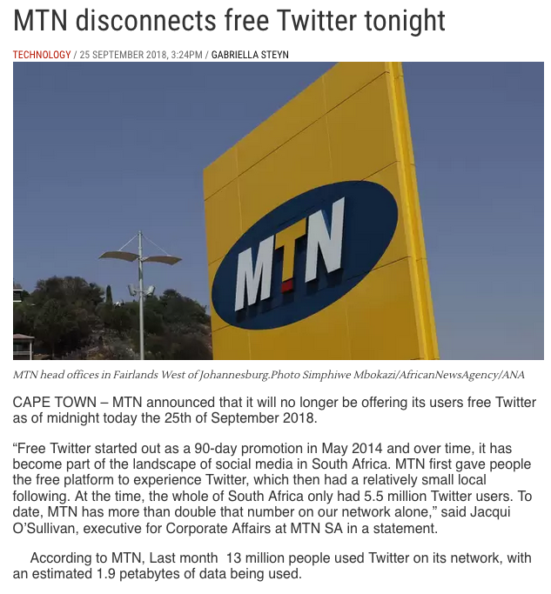
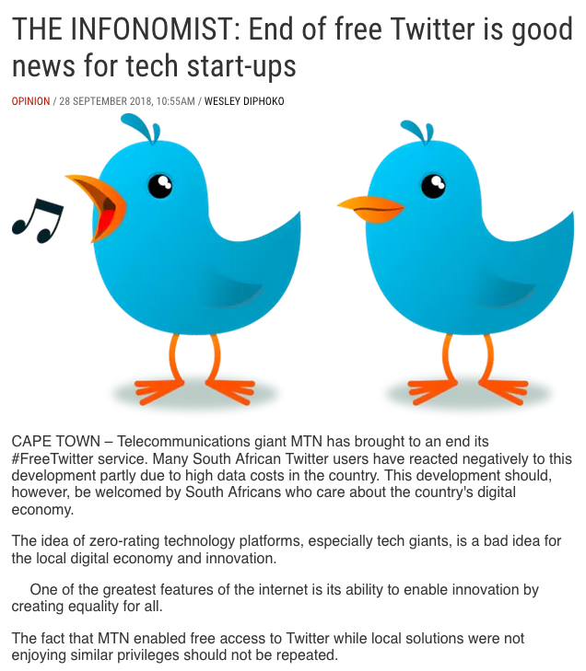
End of Free Twitter (2018)

Slide 61
Comparative Analysis: Surveys from Kenya And South Africa Reasons for using zero-rating
Notes:
116/1000 respondents used zero-rating – penetration is slow
The fact that 2/3 of those who had never used the Internet prior to using a zero-rating application now used paid plans provides evidence against the walled garden argument. Instead, what we see is zero-rated apps serving as a gateway, successfully introducing users to full unlimited Internet usage
Social networking and messaging dominate usage
Majority spend < 16 USD a month on mobile data

Slide 62
Comparative Analysis: Surveys from Kenya And South Africa Reasons for not using zero-rating
Notes:
116/1000 respondents used zero-rating – penetration is slow
The fact that 2/3 of those who had never used the Internet prior to using a zero-rating application now used paid plans provides evidence against the walled garden argument. Instead, what we see is zero-rated apps serving as a gateway, successfully introducing users to full unlimited Internet usage
Social networking and messaging dominate usage
Majority spend < 16 USD a month on mobile data

Slide 63
Zero Rating: Summary
Many users pay high prices for cellular data usage
Preference for Wi-Fi usage except Facebook was clear in studies
Zero rating affects usage, initially and over time
Overall usage of WhatsApp increases during a zero-rating period, regardless of connection type.
Twitter on MTN: increased usage of a zero-rated during and immediately following the zero-rating
Zero-rates is popular, both in Kenya and in South Africa
Zero-rating users prefer full-service applications on a paid plan to limited-service applications on a zero-rated plan.

Slide 64
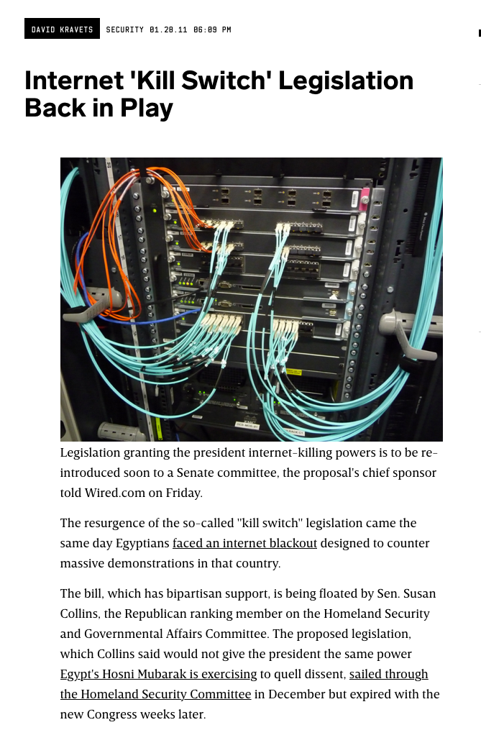
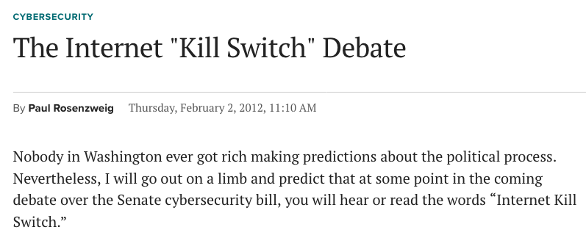
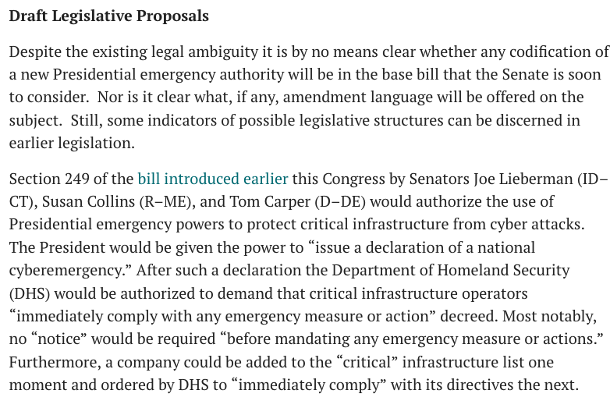
Internet “Kill Switch” Proposals
These bills never tend to become law in the U.S. although they do pop up every now and then.
Generally, President can declare “national cyberemergency” to shut down the Internet (does this make technical sense?)

